Slide 1
The contribution to unpaid care work, by individual and household life cycle stage in Mexico
Estela Rivero
Pulte Institute for Global Development
University of Notre Dame
NTA Global Meeting
August 5, 2020

Slide 2
Motivation
CWW has made important contributions to recognizing the value of women’s work
The recognize, reduce and redistribute (RRR) strategy requires to acknowledge that:
To acknowledge that UCW is done by individuals in different life cycle stages
To recognize that the amount and type of UCW needed within the household also varies with the life cycle
Understand how UCW is distributed within the household

Slide 3
In this presentation
Share of UCW by sex, age group and relationship to household head, and household life cycle
Housework
Children and elderly care
Children and elderly supervisory care
Data refer to Mexico, 2014

Slide 4
Definition of individual and household life cycle stages
Household life cycle stage
Age, sex and relationship to household head
Young, no children
Children 0 to 14 y.o.
Children 15 to 19 y.o.
All grown children
Household head is 60 years or older
Head or spouse
Children 15-29 y.o.
Children 30 y.o. and older
Other household members
+ All disaggregated by sex

Slide 5
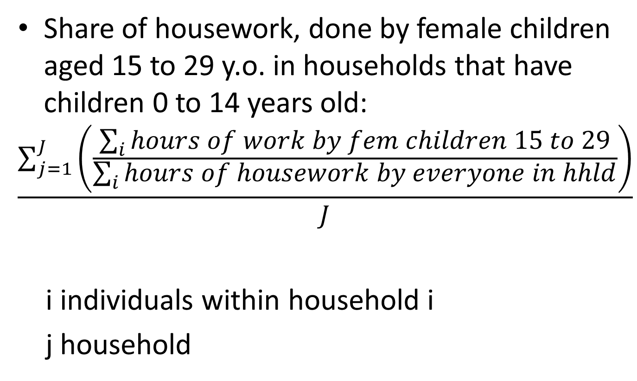
An example:
Share of housework, done by female children aged 15 to 29 y.o. in households that have children 0 to 14 years old:
$$\frac{\sum_{j=1}^{J}{\left(\frac{\sum_{i}{hours of work by fem children 15 to 29}}{\sum_{i}{hours of housework by everyone in hhld}}\right)}}{J}$$
i individuals within household i
j household

Slide 6
Housework
Female heads do most housework
In households with children 15 to 29, female children do 20%
In households where the head is 60+, female children do 15%

Slide 7
Childcare
Female head or spouse does 65%, male head 20%, and young female children 8%

Slide 8
Childcare
Different types of female members always contribute something to childcare

Slide 9
Eldercare
Greater sharing across genders and relationships

Slide 10
Summing up
In general, women do more UCW than men
Disregarding intrahousehold distribution of UCW may lead to:
Ignoring the contribution of children and other household members
Underestimating the inequality across genders
Not recognizing the instances when men contribute

